Slide 1
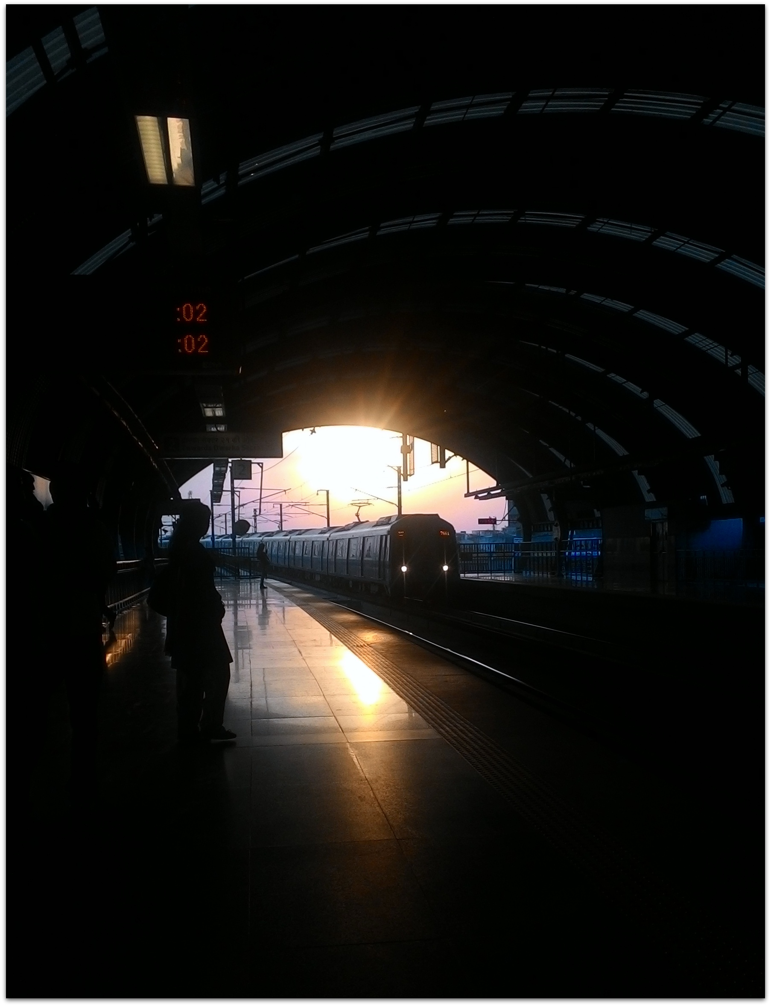
Online Metro Card Recharge
Submitted to : Mrs. Urmil Bharti
Submitted by :
Akanksha Verma(1406627005)
Deepti Sharma(14066270012)
Devashi Singh(14066270013)

Slide 2
Problem Statement

Slide 3
DMRC has a fully automatic fare collection system and issues
Smart Cards for multiple journeys
Smart tokens for single journeys.
The Smart card can be recharged at customer care centres of any metro station
Problem Area: the long waiting queues of metro card recharge waste precious time of the users.
Solution: provide an online portal to smart card users to recharge their metro card themselves.

Slide 4
Overview
This web application : provides the daily metro commuters with a platform to recharge the smart card online.
User has to register with the DMRC as well as on the application.
Recharging methods :
online net banking,
credit/debit card
paytm service.
Users can avail different offers (“Offers of the day “).
Facilities:
maps
balance enquiry,
nearest metro station etc. are also available.

Slide 5
Process Model

Slide 6
Waterfall Model
a description of the sequence of activities carried out in an SE project
, a process model covers the entire lifetime of a product.:
From birth of a commercial idea
To final de-installation of last release
The three main phases:
design,
build,
maintain.
the product we are working on is a simple web application
can simply go from one stage to another after a document was signed by the client.

Slide 7
Communication
Requirements gathered
Planning
Project planning and SRS
Modelling
Architectural Design
Construction
Deployment
Detailed Design and Coding
Testing ,delivery, Maintenance

Slide 8
SRS

Slide 9
SRS
OVERALL DESCRIPTION
PRODUCT FUNCTION:
to recharge the metro card
to create a login of his own,
access various other options as well , like navigate , fare calculator and settings.
USER CHARACTERISTICS:
The user may or may not have much prior knowledge
GENERAL CONSTRAINTS:
application is constrained to allow only Smart card users
The users who may wish to gain knowledge through these extra facilities cannot
ASSUMPTION AND DEPENDENCIES:
users can sign in with a particular metro card number and phone number which is already once registered at the metro station
each metro station will be installed with an RFID punch facility

Slide 10
SRS : Components

Slide 11
1. External Interface Requirements:
User Interface

Slide 12
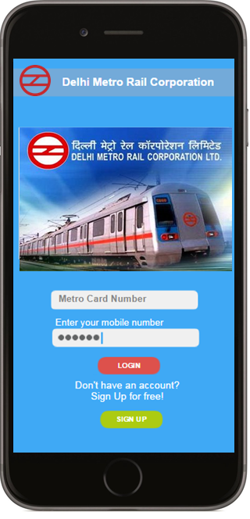
Login

Slide 13
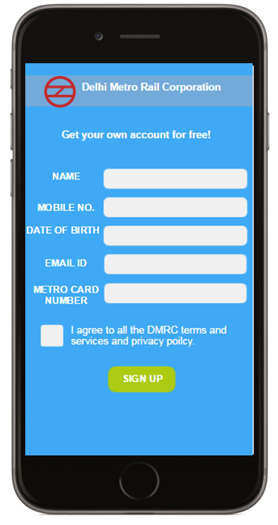
Signup

Slide 14
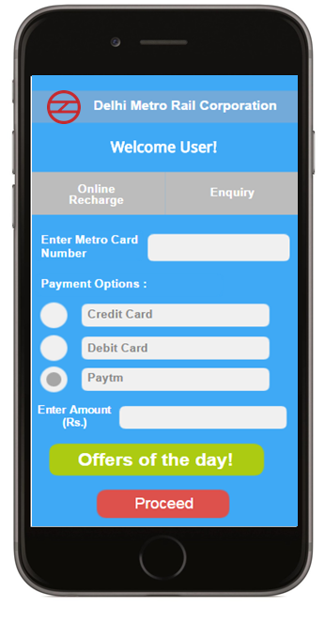
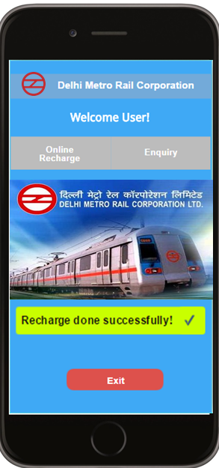
Online Payment

Slide 15
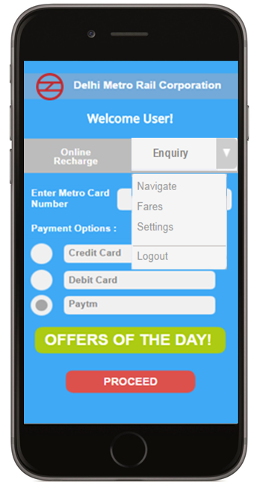
Enquiry

Slide 16
1. External Interface Requirements:
Hardware Interface
And
Software Interface

Slide 17
Hardware Interface
Nominal display
Also internet connection is required to support the online payment
Also we need a special RFID punch facility
SOFTWARE INTERFACE
Special database known as “USER INFO” which is available to the application and the DMRC admin
Also we need a small file known as “Metro details” which contain the data about the metro stations

Slide 18
2. Functional Requirements

Slide 19
FR 1: Signup
Inputs: Name, DOB, mobile number, email Id, Metro Card Number
Output: It does not produce output, Account is created
FR 2: LOGIN
Input: Metro Card Number, Mobile Phone Number
Output: No output

Slide 20
FR 3: Online Payment
Input: Valid data (record read), Metro Card Number, Payment Option, Amount, Rebate option
Output: Payment (to DMRC)
FR 4: Enquiry
Input: Option (=navigate/=fare/=setting/=logout)
Output: Display the data according to the input

Slide 21
FR 5: Enquiry(fare calculator)
Input: Metro station name1, Metro Station Name 2
Output: Metro station distance, Route, Fare, Time
FR 6: Enquiry(Navigate)
Input: Place Name
Output: Metro station
FR 7: Enquiry(Settings)
Input: various options
Output: Confirmation

Slide 22
3. Performance Requirements

Slide 23
Dynamic:
Static:
no limit on the current users,
only 2 files required majorly in the system: The User Information database, The Metro details.
The User Information :a huge database because ; keeps track of issued metro cards
The Metro details : contains each metro station details and fare chart.
respond within 5s after processing and connecting to bank.
In case of an enquiry, response is 5ms.
Throughput is dependent on the terminal also, expecting a nominal system, we can state that the throughput is nearly 3 /ms.

Slide 24
4. Design Constraints

Slide 25
Standard Compliance:
requires no standards to be followed as the data is entered online by the application itself
Hardware limitations:
The software alone is not efficient unless the user punches the card on the hardware on the metro station gate.
Reliability and Fault Tolerance:
It is a reliable and fault tolerating software as it is designed for a very critical scenario.50% Fault tolerance is ensured.
Security:
Login/Password are saved for each user

Slide 26
SRS : DFD And Data Dictionary

Slide 27
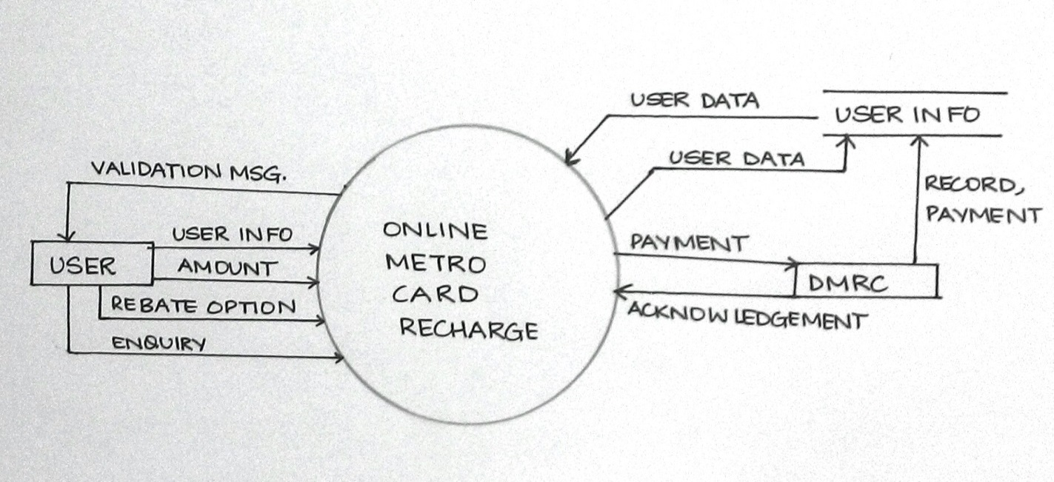
Context Level DFD

Slide 28
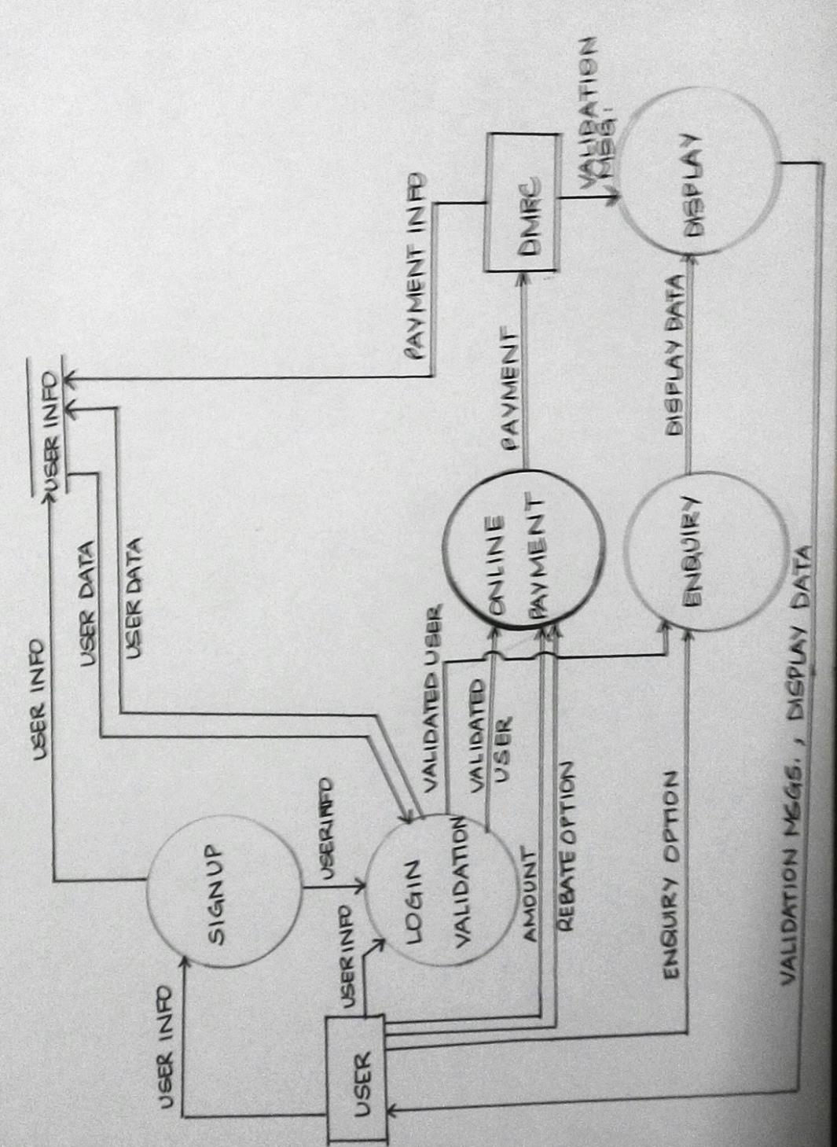
First Level DFD

Slide 29
Data Dictionary
DATA | DESCRIPTION
USER INFO (DATABASE FILE)
1.NAME | VARCHAR(50)
2. MOBILE NUMBER | NUMBER(10)
3. DOB | DATE
4.EMAIL ID | VARCHAR(50)
5. METRO CARD NUMBER | NUMBER(10)
6.PAYMENT | NUMBER(4,2)
7.FLAG | BOOLEAN
8.OFFER NUMBER | VARCHAR(6)

Slide 30
INPUTS:
1.MOBILE NUMBER | Number(10)
2. METRO CARD NUMBER | Number(10)
3. ONLINE RECHARGE | Button, Triggers online payment module to allow user to recharge
4.PAYMENT OPTIONS | Radio button, User can have three options : net banking, credit/debit card, paytm
5.OFFER | Button; A code of alphanumeric form is generated and stored in database to indicate the type of the offer availed(eg :AB2016)
6.OPTION(ENQUIRY)= NAVIGATE | Button, Allows user to search nearest metro station
7.PLACE NAME | Varchar(30)
8.STATION NAME | Varchar(30)
9.OPTION(ENQUIRY)= FARE | Button, Allows user to know the exact amount of the fare
10.OPTION(ENQUIRY)= SETTINGS | Button, Allows user to set the application according to his requirement

Slide 31
Estimation

Slide 32
Estimation: Function Point
PARAMETERS | COUNT | SIMPLE | AVERAGE | DIFFICULT | TOTAL
EXTERNAL INPUT | 36 | 28X3 | 8X4 | 0X6 | 116
EXTERNAL OUTPUT | 14 | 2X4 | 5X5 | 7X7 | 82
EXTERNAL ENQUIRY | 3 | 0X7 | 0X10 | 3X15 | 45
EXTERNAL INTERFACE FILES | 3 | 0X5 | 2X7 | 1X10 | 24
INTERNAL LOGICAL FILES | 3 | 3X3 | 0X4 | 0X6 | 9

Slide 33
FACTOR | VALUE
BACKUP AND RECOVERY | 4
DATA COMMUNICATION | 0
DISTRIBUTED PROCESSING FUNCTIONS | 3
CRITICAL PERFORMANCE | 0
PERFORMANCE IN EXISTING AND HEAVILY UTILISED ENVIRONMENT | 5
ONLINE DATA ENTRY | 5
INPUT TRANSACTION BUILT OVER MULTIPLE SCREENS | 5
ILFS UPDATED ONLINE | 5
INPUTS, OUTPUTS, FILES COMPLEX | 3
INTERNAL PROCESSING COMPLEX | 2
REUSABLE CODE | 3
CONVERSIONS AND INSTALLATIONS INCLUDED | 5
MULTIPLE INSTALLATIONS | 5
CHANGE AND EASE OF USE | 5

Slide 34
Function Point Calculation:
TOTAL=50
COUNT TOTAL = 276
FP=COUNT TOTAL *[0.65+0.01*(TOTAL)]
=276*[0.65+0.01*50]
=317.4

Slide 35
Estimation: Efforts
Using COCOMO II Model;
OP=309
%REUSE=39%
PRODUCTIVITY=13(NOMINAL)
NOP=OP*[100-%REUSE/100]
= 309[100-0.39]
=188.491
EFFORT=NOP/PROD
=188.491/13
=14.49=15(APPROX) pm
OBJECT TYPE | SIMPLE | AVERAGE | DIFFICULT | TOTAL
SCREENS | 0X1 | 0X2 | 13X3 | 39
REPORTS | 0X2 | 8X5 | 0X8 | 40
3GL COMPONENTS | - | - | 23X10 | 230

Slide 36
Scheduling

Slide 37

WORK TABLE: | WEEK1 |  |  |  |  | WEEK 2 |  |  |  |  | WEEK 3 |  |  |  |  | WEEK 4 |  |  |  |  | WEEK 5
IDENTIFY REQUIREMENTS
DEVELOP TIMELINE CHART
DETERMINE BOUNDS
DETRMINE BENEFITS
CREATE USE CASES
ESTABLISH ABSTRACT
MILESTONE: ABSTRACT, TIMELINE CHART,
CONTEXT LEVEL DFD
LEVEL 1 DFD
LEVEL 2 DFD
DEVELOP FP COUNT
DATA DICTIONARY
ESTIMATE EFFORT
MILESTONE: FP COUNT , DFD, DATA DICTIONARY ,EFFORT ESTIMATE
COMPLETE FACTORISATION :LEVEL 1
LEVEL 2 FACTORISATION
ER DESIGN
MILESTONE: DATA DESIGN, SYSTEM DESIGN
DEVELOP PSEUDOCODE
CODING
DETERMINE COMPLEXITY
DETERMINE TEST CASES
MILESTONE: TEST SPEICIFICATION
TESTING

Slide 38
Risk Management

Slide 39
RISKS | CATEGORY | PROBABILITY | IMPACT
CUSTOMER WILL CHANGE REQUIREMENT | PS | 80 | 2
END USERS RESIST USE | BU | 70 | 2
FUND LOST | BU | 60 | 2
SIZE ESTIMATE MAY BE INCORRECT | PS | 60 | 2
NEW COMPETENT SOFTWARE | BU | 50 | 2
CANNOT CONNECT TO BANK | TD | 50 | 1
SRS NOT DEFINED PROPERLY | PD | 40 | 2
LESS REUSE THAN PLANNED | PS | 40 | 3
IMPROPER WORKING CONDITON | DE | 40 | 3
LACK OF MUTUAL UNDERSTANDING | ST | 40 | 4
STAKEHOLDER REFUSES TO INVEST | SC | 30 | 1
LACK OF TRAINING | DE | 30 | 2
INEXPERIENCED STAFF | ST | 30 | 2
S/W QUALITY NOT UPTO MARK | PS | 30 | 2
TECHNOLOGY NOT MEETING EXPECTATION | TD | 20 | 1
RECESSION TIME | SC | 20 | 2
RELOCATION OF WORK PLACE | DE | 10 | 3

Slide 40
Design: System Design

Slide 41
OnlineMetro Card recharge
signup
acquire
validate
login
acquire
online payment
acquire
process payment
enquiry
user detail input
connect
record payment
fare
navigator
setting
acquire
process
acquire
process
acquire
process
display

Slide 42
Design: Data Design

Slide 43
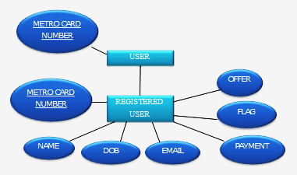
There are no multiple tables in the database. Only two: user and registered user. Users actually contain the data of all the metro card numbers which have been issued and registered user contains the subclass of all the users who have signed up using this application.

Slide 44
Coding

Slide 45
Pseudocode: Payment Process
Input: payment_amount
Variable: exist_amount, flag
Begin:
Read payment into exist_amount , flag into flag from database(user INFO)
If(payment_amount>0 && payment_amount<1001)
Flag=1
Record in database
Exist_amount=payment_amount+exist_amount
Record in database
Else if (payement_amount==0)
Flag=0
Record in database
Else //payment_amount<0
Prompt to enter again
Return

Slide 46
Testing

Slide 47
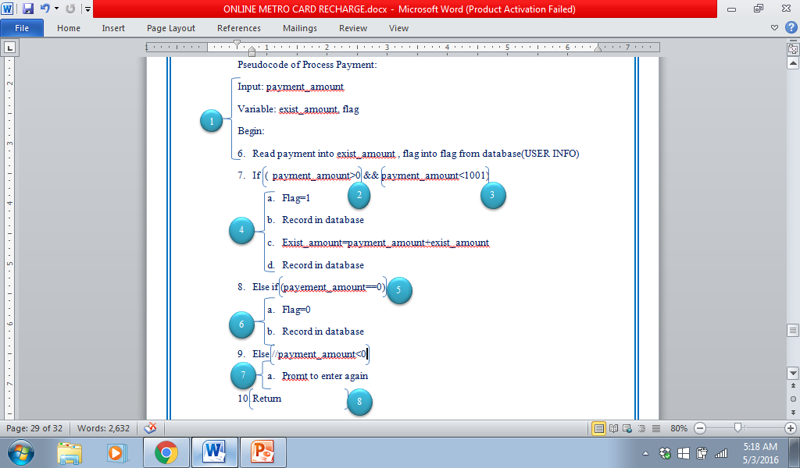

Slide 48
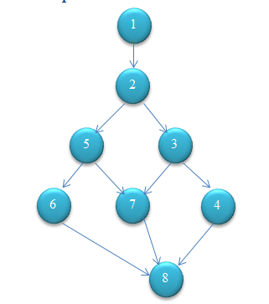
Cyclomatic Complexity

Slide 49
Regions=4
Predicate Nodes+1: 3+1=4
Edges-Vertices+2=10-8+2=4
Independent Paths:
1 => 2 => 3 => 4 => 8
1 => 2 => 3 => 7 => 8
1 => 2 => 5 => 6 => 8
1 => 2 => 5 => 7 => 8
Test Cases:
Enter payment =0
Output: Nil, no updates
Enter payment=-99
Output: Prompts to enter again
Enter payment>0 and <1001
Output: Recharge Successful
Enter Payment =1005
Output: Prompts to enter again

Slide 50
References

Slide 51
R.W. Royce, Managing the Development of Large Software Systems: Concepts and Techniques, Proc. IEEE Westcon, IEEE Press, 1970.
Software Engineering : Practitioner’s Approach :By Roger S. Pressman
An Integrated Approach to Software Engineering by Pankaj Jalote

